Slide 1
Fundamental of Cloud Computing and IoT
Chapter Two
Service and Deployment
Model for Cloud Computing

Slide 2
Fundamental of Cloud Computing
and IoT
Introduction to Cloud Computing
Service and Deployment Model
Cloud Challenges and Security issues
01
02
03
Evolution
Definition
Characteristics of cloud Computing
Advantage and Dis advantage
Benefit of Cloud computing
Application of Cloud Computing
Datacenter and Virtualization
Service Model
IAAS
PAAS
SAAS
Deployment Model
Public
Private
Hybrid
Cloud Computing Challenge
Cloud Computing Privacy
Big Data and Cloud Security
Data Security
06
Introduction to IoT
Data management in Cloud and Big Data
Introduction to IoT
Application
Device and Wireless Network
04
05
Advanced Cloud Concepts
Data Management in Cloud
Big Data Analytics
Cloud Management
Data Management
Regulatory Compliance
Forensics and Malware
Miscellaneous Topic in the Cloud
DevOps and the Cloud
IaaS Networking
IoT Device and Architecture
07

Slide 3
Fundamental of Cloud Computing
and IoT
02
Service and Deployment Model for Cloud Computing
Service Model
IAAS
PAAS
SAAS
Deployment Model
Public
Private
Hybrid

Slide 4
02
Cloud Service Delivery Model
Cloud computing has transformed the way companies use technology.
To do that, you first need to understand the function of each cloud delivery model.
Secondly understand the Shared Security Responsibility required for each model.
Lastly, choose the model that aligns best with your business objectives.
There are three main cloud service delivery models:
Infrastructure as a Service (IaaS)
Platform as a Service (PaaS)
Software as a Service (SaaS)

Slide 5
02
Cloud Service Delivery Model
The Infrastructure as a Service layer offers storage and compute resources that developers and IT organizations use to deliver custom business solutions.
The Platform as a Service layer offers development environments that IT organizations can use to create cloud-ready business applications.
The Software as a Service layer offers purpose-built business applications.

Slide 6
02
Cloud Service Delivery Model
Infrastructure as a Service (IaaS)
Infrastructure as a Service (IaaS) is the delivery of computer hardware (servers, networking technology, storage, and data center space) as a service.
It may also include the delivery of operating systems and virtualization technology to manage the resources.
The IaaS customer rents computing resources instead of buying and installing them in their own data center.
Example: DigitalOcean, Linode, Amazon Web Services (AWS), Microsoft Azure, Google Compute Engine (GCE), Rackspace, and Cisco Metacloud.

Slide 7
02
Cloud Service Delivery Model
Benefits of using IaaS include:
Greater flexibility: IaaS lets you access infrastructure services on demand. You can scale infrastructure to support business growth and reduce it when needed.
Cost savings: You don’t have to buy physical hardware every time you want to upgrade. Your computing infrastructure is provided on a subscription basis, meaning your vendor is the one responsible for infrastructure management.
Reliability: Your assets are stored in a remote data center, where it’s managed by cloud service providers. This service model all but eliminates the threat of a single point of failure.

Slide 8
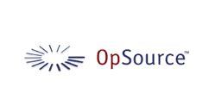




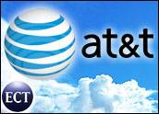
IaaS Examples

Slide 9
02
Cloud Service Delivery Model
Platform as a Service (PaaS)
This type of cloud service delivery model is also known as a solution stack.
It enables organizations to create, run, and manage cloud-based software without the need for onsite infrastructure.
Platforms are provided and maintained by a third-party vendor.
This means businesses don’t have to worry about activities like backups and provisioning servers––it’s all done for them.
Example: AWS Elastic Beanstalk, Windows Azure, Heroku, Force.com, Google App Engine, Apache Stratos, Magento Commerce Cloud, and OpenShift.

Slide 10
02
Cloud Service Delivery Model
Benefits of PaaS include:
Improved efficiency: Since a third party handles your IT infrastructure needs, businesses can spend more time focusing on developing, testing, and deploying applications.
Simplicity: PaaS gives businesses a platform with development tools, so they can develop, test, and host applications in the same environment.
Better collaboration: PaaS requires teams to develop over the internet, eliminating the need to transfer files and manually sync data. Everyone works with the same up-to-date information at all times.

Slide 11
Platform as a Service (PaaS)
PaaS provides all of the facilities required to support the complete life cycle of building and delivering web applications and services entirely from the Internet.
Typically applications must be developed with a particular platform in mind
Multi tenant environments
Highly scalable multi tier architecture

Slide 12

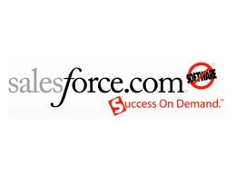
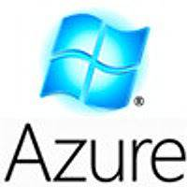



PaaS Examples

Slide 13
02
Cloud Service Delivery Model
Software as a Service(SaaS)
SaaS is the most well-known of the three cloud service delivery models. That’s because most people use SaaS applications every day, whether they know it or not.
When people talk about “the cloud,” they’re often talking about SaaS applications like Google Drive, Dropbox, or even Netflix.
The SaaS delivery model lets users access fully functional software that’s managed and run in the cloud.
Users typically access SaaS applications through a web browser. The advantage of this is that you don’t have to worry about downloading and installing programs, because the vendor takes care of that.

Slide 14
02
Cloud Service Delivery Model
Examples
CRM
Financial Planning
Human Resources
Word processing
Commercial Services:
Salesforce.com
emailcloud
4

Slide 15
02
Cloud Service Delivery Model
Some key benefits of SaaS include:
It’s lightweight: Running SaaS applications doesn’t typically require as many computing resources as on-premises software.
No need for software updates: Vendors manage and update SaaS applications. That means everyone has access to the most up-to-date version at all times.
No more software licensing: Premium SaaS applications follow the subscription model, which means you don’t have to worry about buying and renewing software licenses.

Slide 16
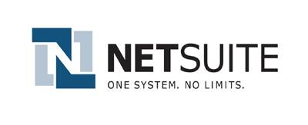
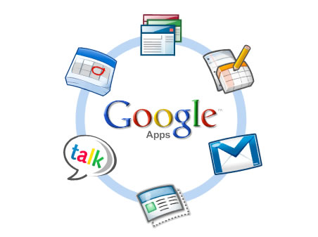

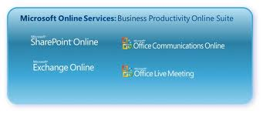

SaaS Examples

Slide 17
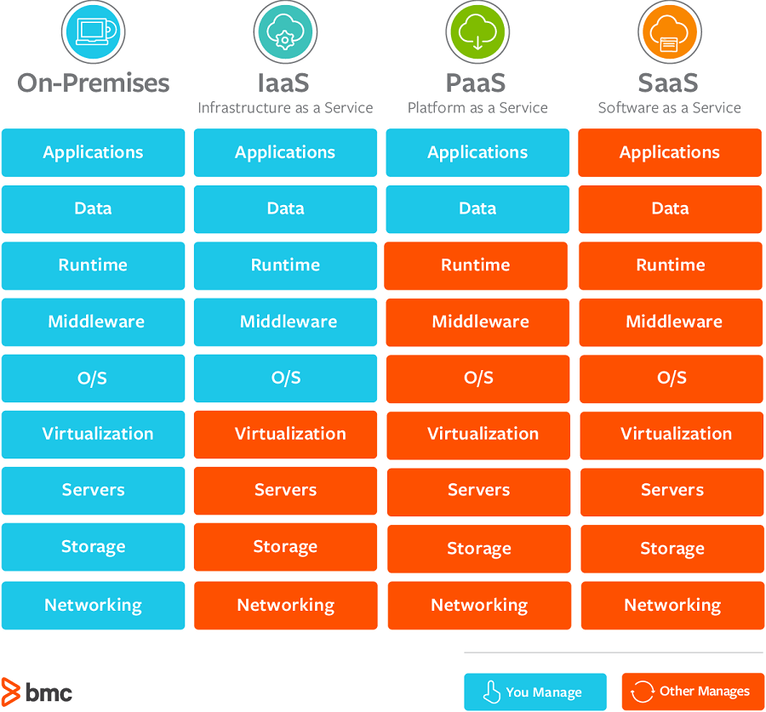
02
Cloud Service Delivery Model

Slide 18
01
Cloud Service Delivery Model
Which Cloud Computing Model Is Right for Your Business?
There are a lot of things to consider when adopting cloud technology.
You want to make sure the model you choose is cost-effective and capable of helping you meet your business demands.
All three cloud models provide businesses with an excellent alternative to on-premises solutions.
But each cloud computing model comes with its own benefits and drawbacks.

Slide 19
01
Cloud Service Delivery Model
Which Cloud Computing Model Is Right for Your Business?
Choosing the right option for your organization depends largely on your needs and what you hope to gain from migrating to cloud services.
Successful cloud migration doesn’t have to be hard,
Once you understand your company’s needs and strategic goals, you can choose a model that complements your business outcomes and delivers value to your organization.

Slide 20
01
Cloud Service Delivery Model
When you should use SaaS?
SaaS is the best model for companies that need applications, but don’t have a need for developing an up-to-date infrastructure. As such, this makes SaaS a great excellent solution for small- and medium-sized businesses that:
Need to support remote work
Frequently require teams to collaborate on projects
Don’t have the resources or need to deploy on-premises hardware
Keep in mind that SaaS prioritizes configuration over customization.

Slide 21
01
Cloud Service Delivery Model
When you should use IaaS?
If your organization requires more computing power but you don’t have the time or resources to upgrade your on-premises IT infrastructure, IaaS can help.
Then once an IaaS vendor is selected, you need to decide which type of service model you want:
A private cloud that’s used exclusively by your organization.
A public cloud that’s used by multiple organizations.
A hybrid cloud that uses both public and private infrastructure.

Slide 22
01
Cloud Service Delivery Model
When you should use PaaS?
If your organization requires a flexible computing platform, PaaS is your best bet, as it gives you the tools to quickly build, test, and deploy applications, so you can develop iteratively and modify software based on customer feedback.
Here are some reasons why you may want to implement PaaS:
You have projects that require collaborating with multiple developers.
Your business model requires you to have shorter development cycles.
You need a solution that enables you to scale your applications as needed, without putting a strain on internal resources.

Slide 23
Deployment Model
The cloud deployment model identifies the specific type of cloud environment based on ownership, scale, and access, as well as the cloud’s nature and purpose.
There are four primary cloud deployment models :
Public Cloud
Private Cloud
Community Cloud
Hybrid Cloud

Slide 24
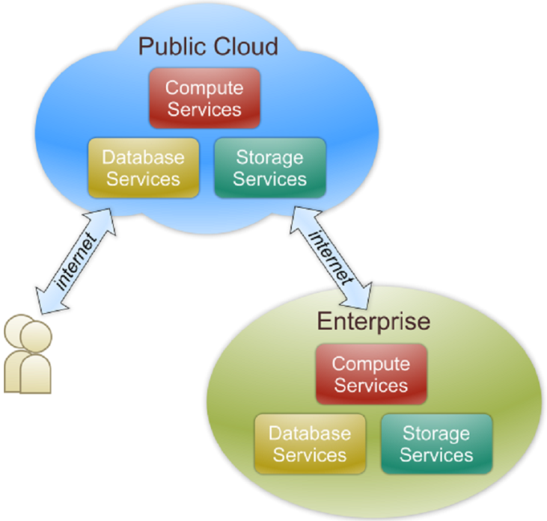
Public Cloud
Public cloud definition
The cloud infrastructure is made available to the general public or a large industry group and is owned by an organization selling cloud services.
Also known as external cloud or multi-tenant cloud, this model essentially represents a cloud environment that is openly accessible.
Basic characteristics :
Homogeneous infrastructure Common policies
Shared resources and multi-tenant Leased or rented infrastructure
Economies of scale

Slide 25
Public Cloud
The location remains, thus, separate from the customer and he has no physical control over the infrastructure.
As public clouds use shared resources, they do excel mostly in performance, but are also most vulnerable to various attacks.
GlobalDots offers worldwide Public Cloud service in leading data centers.

Slide 26
Private Cloud
It provides the same benefits of Public Cloud, but uses dedicated, private hardware.
Private cloud means using a cloud infrastructure (network) solely by one customer/organization.
It is not shared with others, yet it is remotely located.
The companies have an option of choosing an on-premise private cloud as well, which is more expensive, but they do have a physical control over the infrastructure.
The security and control level is highest while using a private network.
Yet, the cost reduction can be minimal, if the company needs to invest in an on-premise cloud infrastructure.

Slide 27
Private Cloud
With our Private Cloud you'll get:
Increased redundancy
Decreased provisioning time for new servers 
Saved capital by eliminating hardware support contracts 
Quicker expendability compared to hosting your own physical servers
Use of dedicated, private hardware

Slide 28
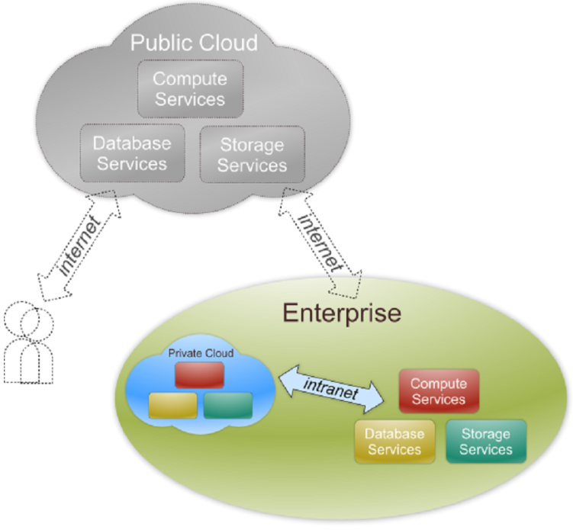
Private Cloud
Also referred to as internal cloud or on-premise cloud, a private cloud intentionally limits access to its resources to service consumers that belong to the same organization that owns the cloud.
Basic characteristics :
Heterogeneous infrastructure
Customized and tailored policies
Dedicated resources
In-house infrastructure
End-to-end control

Slide 29
Public vs. Private
 | Public Cloud | Private Cloud
Infrastructure | Homogeneous | Heterogeneous
Policy Model | Common defined | Customized & Tailored
Resource Model | Shared & Multi-tenant | Dedicated
Cost Model | Operational expenditure | Capital expenditure
Economy Model | Large economy of scale | End-to-end control

Slide 30
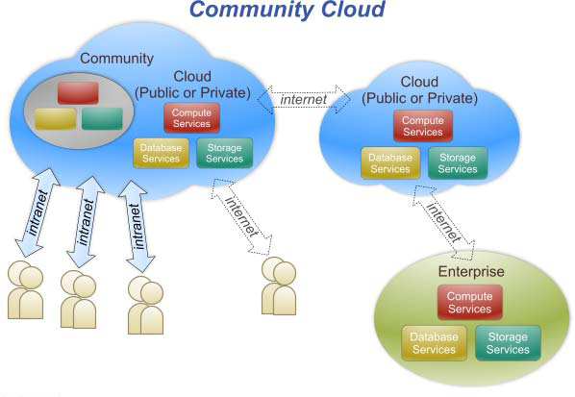
Community Cloud
Community cloud definition
The cloud infrastructure is shared by several organizations and supports a specific community that has shared concerns (e.g., mission, security requirements, policy, and compliance considerations).
It implies an infrastructure that is shared between organizations, usually with the shared data and data management concerns.
For example, a community cloud can belong to a government of a single country.
Community clouds can be located both on and off the premises.

Slide 31
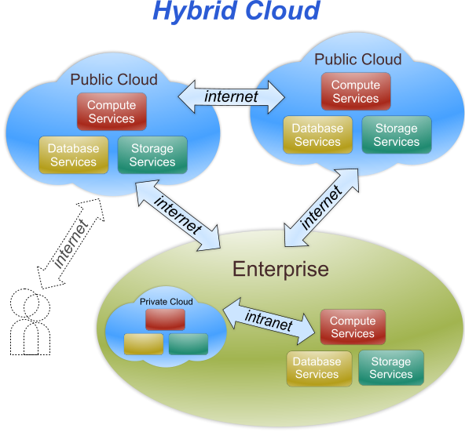
Hybrid Cloud
Hybrid cloud definition
The cloud infrastructure is a composition of two or more clouds (private, community, or public) that remain unique entities but are bound together by standardized or proprietary technology that enables data and application portability (e.g., cloud bursting for load-balancing between clouds).

Slide 32
Hybrid Cloud
Hybrid cloud, of course, means, using both private and public clouds, depending on their purpose.
For example, public cloud can be used to interact with customers, while keeping their data secured through a private cloud.
Most people associate traditional public cloud service with
elastic scalability and the ability to handle constant shifts in demand.
However, performance issues can arise for certain data-intensive or high-availability workloads.

Slide 33
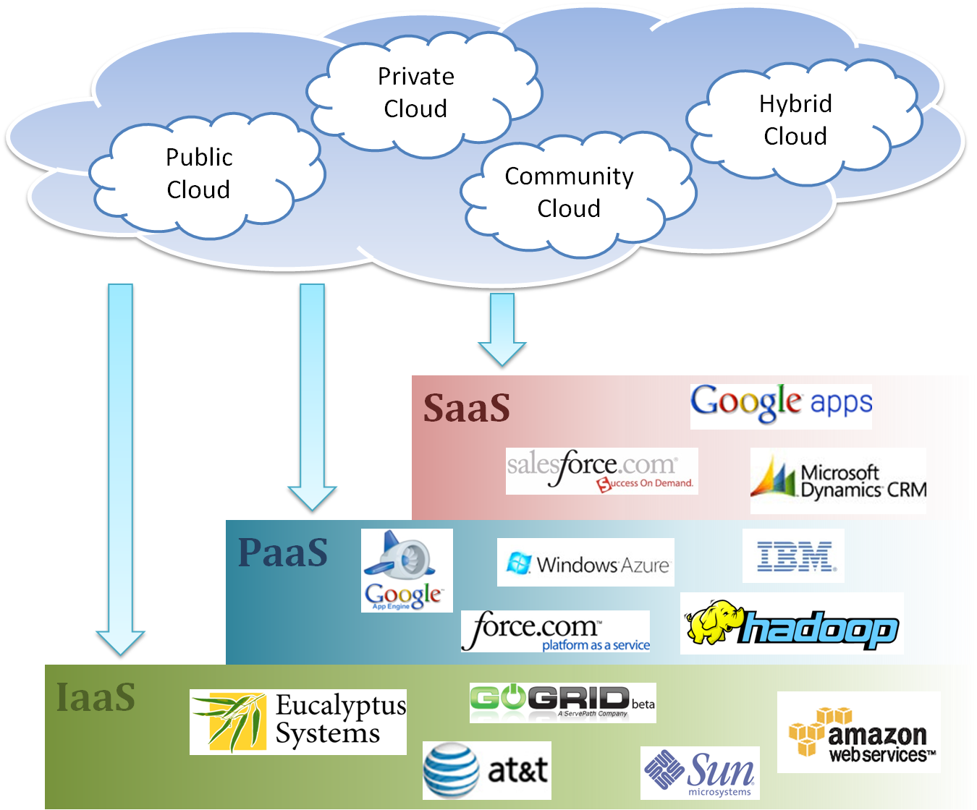
Cloud Ecosystem

Slide 34

Service Level Agreement
A service-level agreement (SLA) is a contract between a network service provider and a customer that specifies, usually in measurable terms (QoS), what services the network service provider will furnish
Common content in contract
Performance guarantee metrics
Up-time and down-time ratio
System throughput
Response time
Problem management detail
Penalties for non-performance
Documented security capabilities

Slide 35
Virtualization
Virtualization in computing is creation of virtual (not real) of virtual something such as hardware, software, platform or a operating system or a storage or a network device.
In a virtualized environment IT enterprise has to manage many changes as the changes occur more quickly in virtual environment than in a physical environment.
Because of virtualization clouds are scalable and agile.

Slide 36
Virtualization
Virtualization is the ability to run multiple operating systems on a single physical system and share the underlying hardware resources
It is the process by which one computer hosts the appearance of many computers.
Virtualization is used to improve IT throughput and costs by using physical resources as a pool from which virtual resources can be allocated.

Slide 37
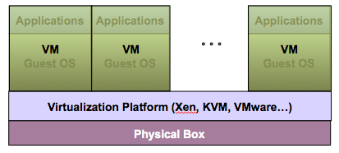
Virtualization Architecture
A Virtual machine (VM) is an isolated runtime environment (guest OS and applications)
Multiple virtual systems (VMs) can run on a single physical system

Slide 38
Benefits of Virtualization
Sharing of resources helps cost reduction
Isolation: Virtual machines are isolated from each other as if they are physically separated
Encapsulation: Virtual machines encapsulate a complete computing environment
Hardware Independence: Virtual machines run independently of underlying hardware
Portability: Virtual machines can be migrated between different hosts.

Slide 39
Hypervisor
A hypervisor, a virtual machine manager/monitor (VMM), or virtualization manager, is a program that allows multiple operating systems to share a single hardware host.
Each guest operating system appears to have the host's processor, memory, and other resources all to itself.
However, the hypervisor is actually controlling the host processor and resources, allocating what is needed to each operating system in turn and making sure that the guest operating systems (called virtual machines) cannot disrupt each other.

Slide 40
Virtualization in Cloud Computing
Cloud computing takes virtualization one step further:
You don’t need to own the hardware
Resources are rented as needed from a cloud
Various providers allow creating virtual servers:
Choose the OS and software each instance will have
The chosen OS will run on a large server farm
Can instantiate more virtual servers or shut down existing ones within minutes
You get billed only for what you used

Slide 41
Virtualization Security Challenges
The trusted computing base (TCB) of a virtual machine is too large.
TCB: A small amount of software and hardware that security depends on and that we distinguish from a much larger amount that can misbehave without affecting security*
Smaller TCB → more security
*Lampson et al., “Authentication in distributed systems: Theory and practice,” ACM TCS 1992

Slide 42
Summary
What is cloud computing in your mind
Clear or Cloudy?
Cloud computing is a new paradigm shift of computing
Cloud computing can provide high quality of properties and characteristics based on essentially central ideas
Service models and deployment models provide services that can be used to
Rent fundamental computing resources
Deploy and develop customer-created applications on clouds
Access provider’s applications over network (wired or wireless)

Slide 43
Thank You
Question ??
4

